Slide 1
Data Mining, ID2222
Homework 3
Mining data streams
Group 20: Frano Rajic, Ivan Stresec

Slide 2

chosen paper:

Slide 3
Implementation
Python 3, built-in functions
TRIEST is built upon the reservoir algorithm
Triest class, features two approaches
TRIEST-BASE
TRIEST-IMPR
improves upon the base version

Slide 4
Reservoir (edge) sampling
standard implementation - stream of edges
increase time t by 1 for each new sample (0 at start)
save edges until M (capacity) reached
when M is reached flip a coin with p(heads) = M/t
heads: remove random edge and add new
tails: do nothing

Slide 5


TRIEST-BASE
builds on top of reservoir sampling
keeps several counters used for estimates
can estimate the number of global and local triangles at any moment

Slide 6

TRIEST-IMPR
improved version of TRIEST-BASE
slight changes to the base version
increases counters before deciding if an edge is kept
the increase of counters is weighted (not just ones)
never decreases counters
more accurate results (lower variance)

Slide 7
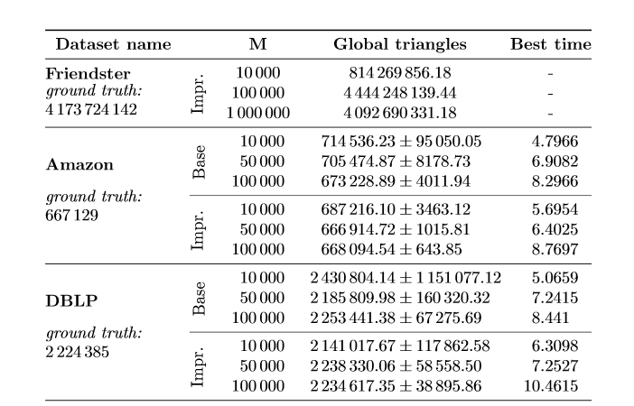
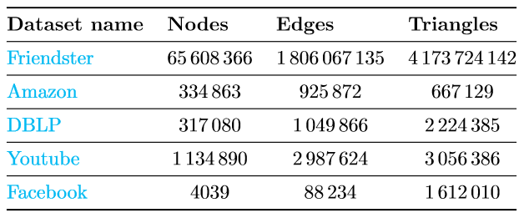
Test results

Slide 8
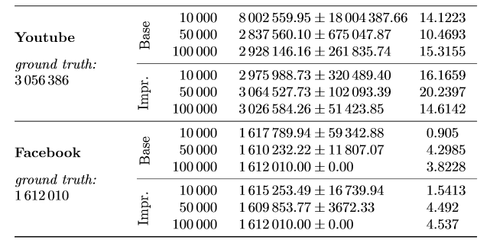
Test results

